Slide 1
Covid Dashboard
File created on: 1.09.2021 23:45:32
.Twb file can be found in repository for Tableau desktop.

Slide 2
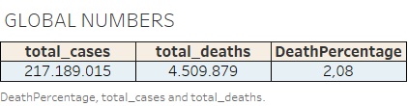

Slide 3
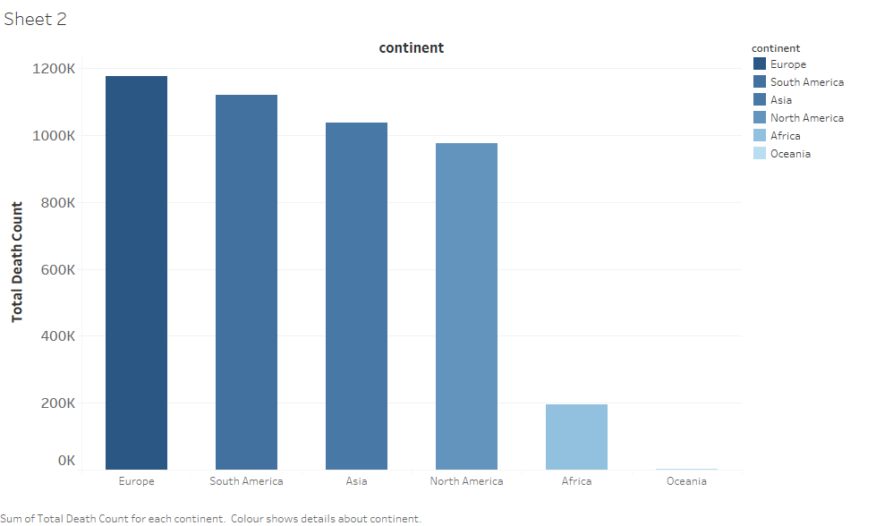

Slide 4
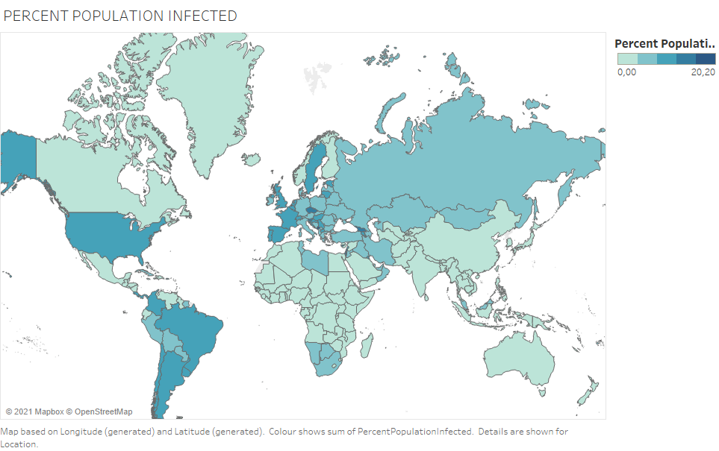

Slide 5
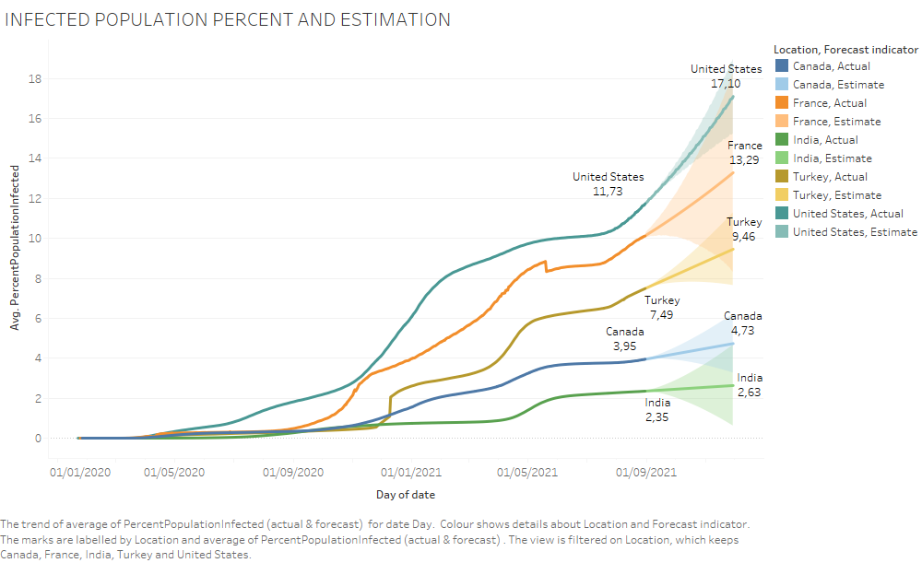

Slide 6
